Slide 1
CSE 471 - Lab 06
Activity Diagram

Slide 2
Activity Diagram
Model business process
Use case, multiple related use cases, portion of a large use case
Focus on flow of actions, sequence, alternate pathways, concurrency

Slide 3
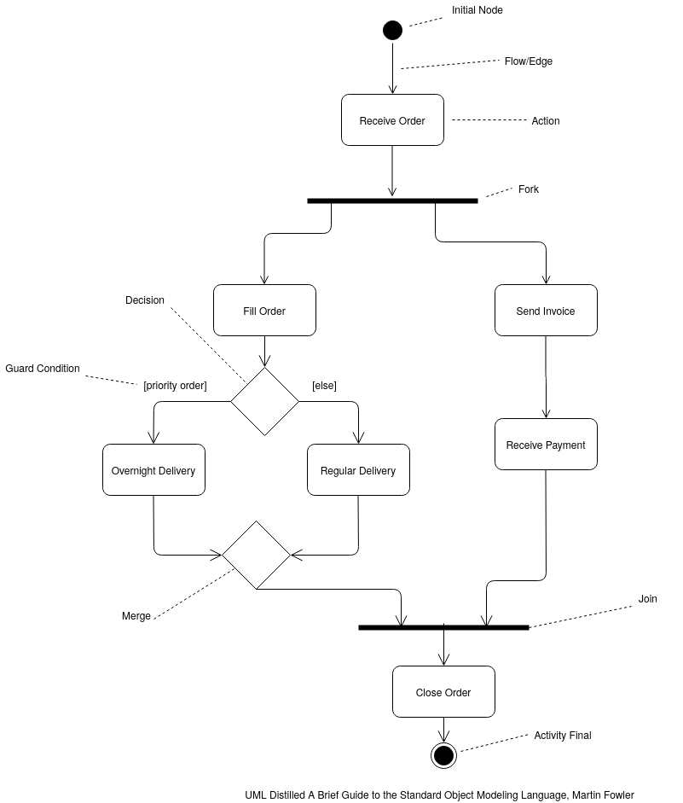

Slide 4
Software Installation
User first enters the URL of the download link into a browser and downloads the software. If the site is unreachable or downloading fails for any reason, the process will end here. After the download is finished, user will double-click on the file and an installer window will be opened. User will be prompted to provide an installation folder. They can choose either default or custom location for the installation. If a custom location is provided, installer will use this address to install the software. After this, all necessary modules will be downloaded to default temp directory. Installer will then check for duplication regarding previously installed version of the same software. If duplication is found, User can choose to replace the existing folder or abort the installation process. Whether installing a fresh version of the application or replacing previous version, installer will then start two independent tasks. One to create appropriate registry entries and the other to copy necessary software files to designated locations. Only after both processes are finished, installer will make a mandatory update of the installed software. After a successful update, user will be shown a confirmation message and installation process will end.

Slide 5
Software Installation
User first enters the URL of the download link into a browser and downloads the software. If the site is unreachable or downloading fails for any reason, the process will end here. After the download is finished, user will double-click on the file and an installer window will be opened. User will be prompted to provide an installation folder. They can choose either default or custom location for the installation. If a custom location is provided, installer will use this address to install the software. After this, all necessary modules will be downloaded to default temp directory. Installer will then check for duplication regarding previously installed version of the same software. If duplication is found, User can choose to replace the existing folder or abort the installation process. Whether installing a fresh version of the application or replacing previous version, installer will then start two independent tasks. One to create appropriate registry entries and the other to copy necessary software files to designated locations. Only after both processes are finished, installer will make a mandatory update of the installed software. After a successful update, user will be shown a confirmation message and installation process will end.

Slide 6
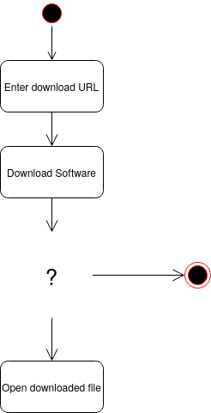

Slide 7
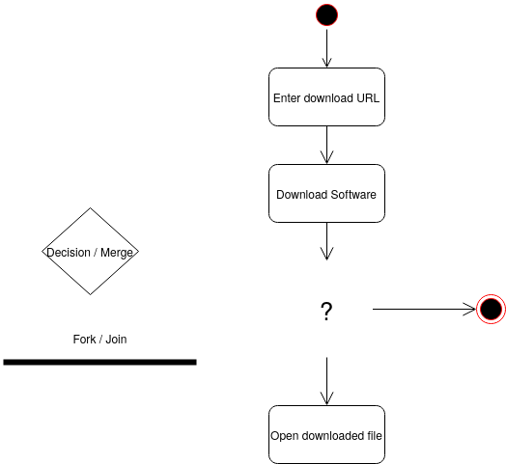

Slide 8
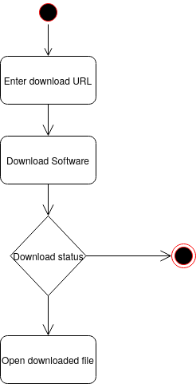

Slide 9
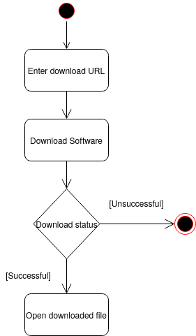

Slide 10
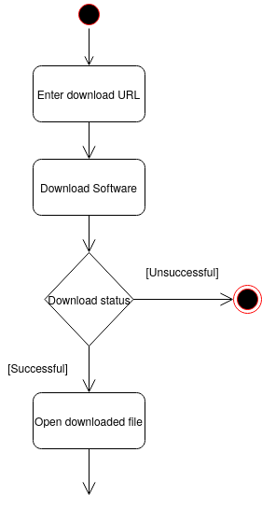

Slide 11
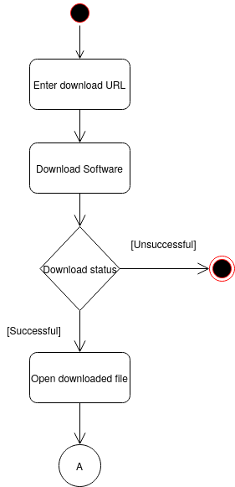

Slide 12
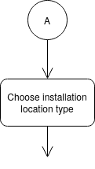

Slide 13
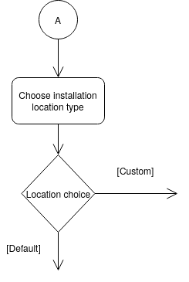

Slide 14
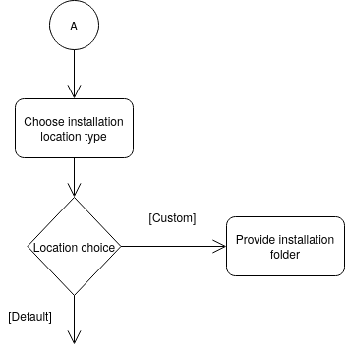

Slide 15
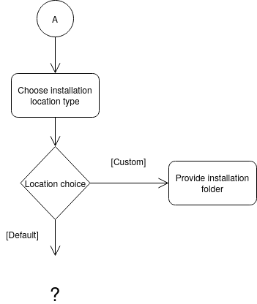

Slide 16
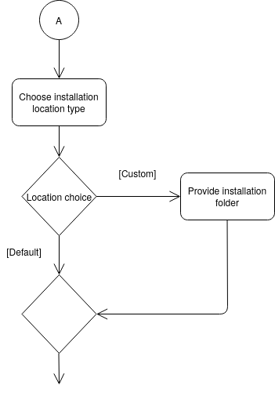

Slide 17
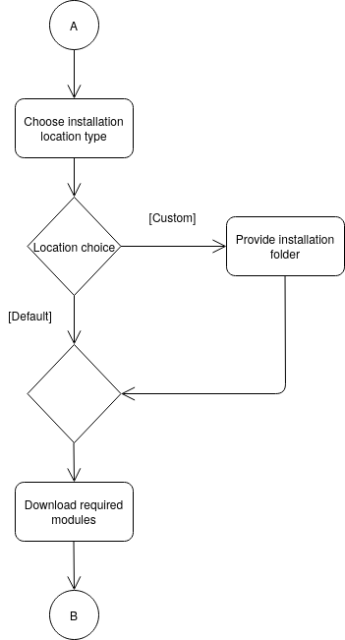

Slide 18
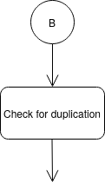

Slide 19
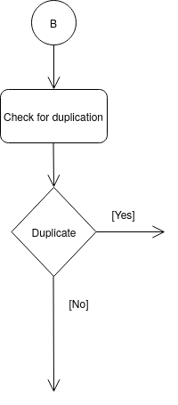

Slide 20
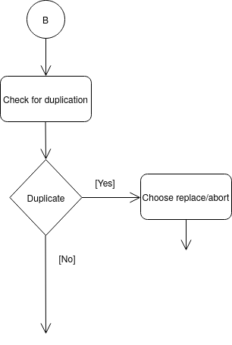

Slide 21
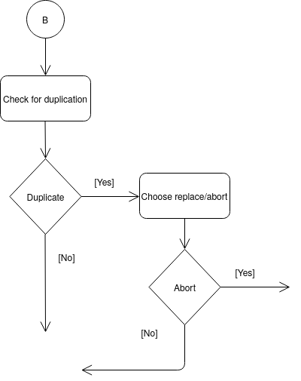

Slide 22
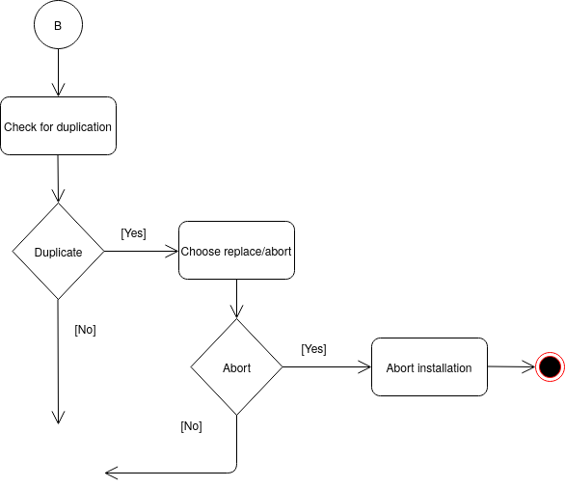

Slide 23
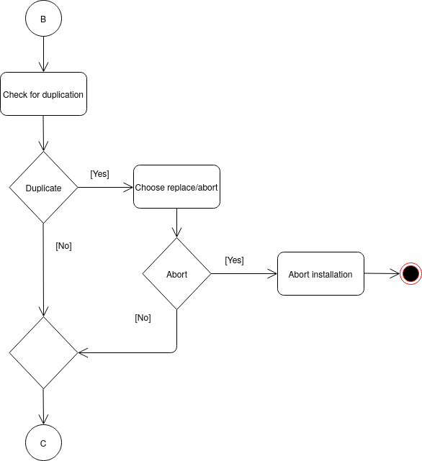

Slide 24


Slide 25
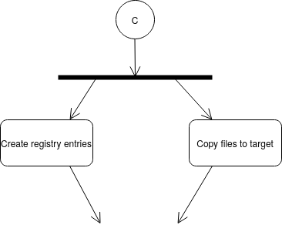

Slide 26
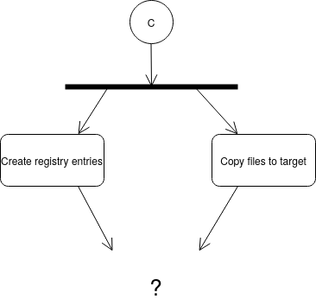

Slide 27
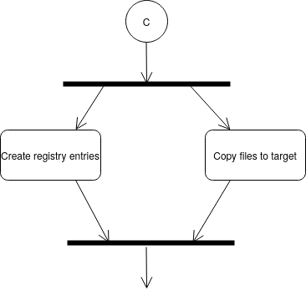

Slide 28
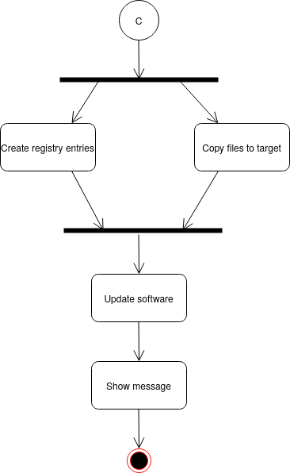

Slide 29
